Slide 1
Decision Tree Modeling in R
DARTH workgroup

Slide 2
Decision Tree (a type of model)
Schematic representation of all of the important outcomes of a decision (e.g., clinical, economic, non-health sectors)
Used to combine knowledge about decision problem from many sources
Computes average outcomes (e.g., costs, events, QALYs) from decisions
Notes:
So let’s start with: “what is a decision tree”
A decision tree is a decision support tool that gives a schematic representation of all the important possible consequences of a decision.
We can use this decision tree tool combine knowledge about the decision problem from many sources. For example, the treatment effect comes from a clinical trial, while the age specific mortality comes from national observation studies.
And for comparisons of the decision, the tree computes the average outcomes

Slide 3
Components of a decision tree
The alternative strategies of a decision making process
The events that follow from application of any of these strategies and their likelihood
The outcomes (for an individual, a cohort or a population)
Notes:
In general every decision tree has be split in three components.
Firstt we start with the alternative strategies or alternative decision we are considering.
Second the event that follow from selecting a strategy and the likelihood of these evenst under the cersomstances of slecting this strategy
And third and last the outcomes related to the sequence of events.

Slide 4
Structure of a decision tree
A tree consists of 3 different types of nodes connected via branches:
A decision tree starts with a decision node, which represents the choices a decision maker has between mutually exclusive strategies
A chance node represents possible events that could occur following a decision or a previous event. We include probabilities of these events in the tree.
A terminal node represents end points of each complete branch and the outcome associated with it.

Slide 5
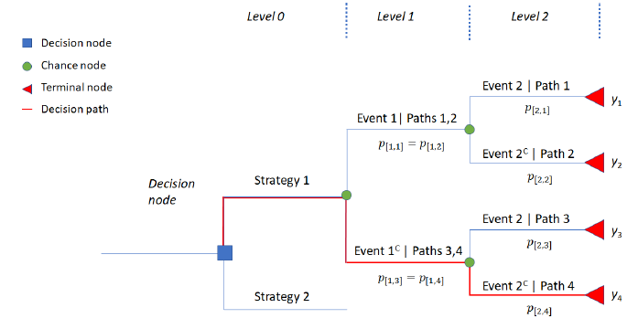
Plot of a sample decision tree
Event 2
Event 1
Not Event 2
Event 2
Not Event 1
Not Event 2
Compute average outcomes: a “folding back” method

Slide 6
Simple Decision Tree
Viral encephalitis can be caused by herpes virus (HVE) or other viruses (OVE); Pr(HVE) = 52%.
Untreated HVE leads to severe sequelae in 71%; for OVE this is 1%.
A drug, vidarabine, decreases severe sequelae due to HVE from 71% down to 36%.
Side effects cause an increase in severe sequalae among OVE patients treated with vidarabine from 1% to 20%.

Slide 7
Draw the tree

Slide 8
To treat or not to treat
HVE
0.36
0.52
Treat
0.48
OVE
0.20
HVE
0.71
0.52
Do not treat
0.48
OVE
0.01
Outcome = Pr(severe sequelae)

Slide 9
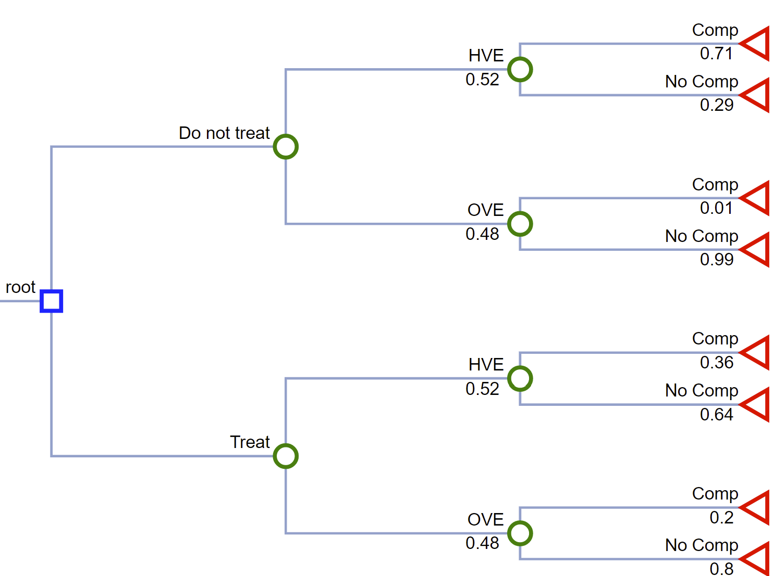
0.52*0.36 + 0.48*0.20 = 0.2832

Slide 10
0.52*0.71 + 0.48*0.01 = 0.3740

Slide 11
There is a third option
It is possible to obtain a definitive diagnosis by means of brain biopsy, but this procedure itself carries a risk of mortality of 0.5%.
Outcome = Pr(severe sequelae and/or dead)

Slide 12
Draw the tree

Slide 13
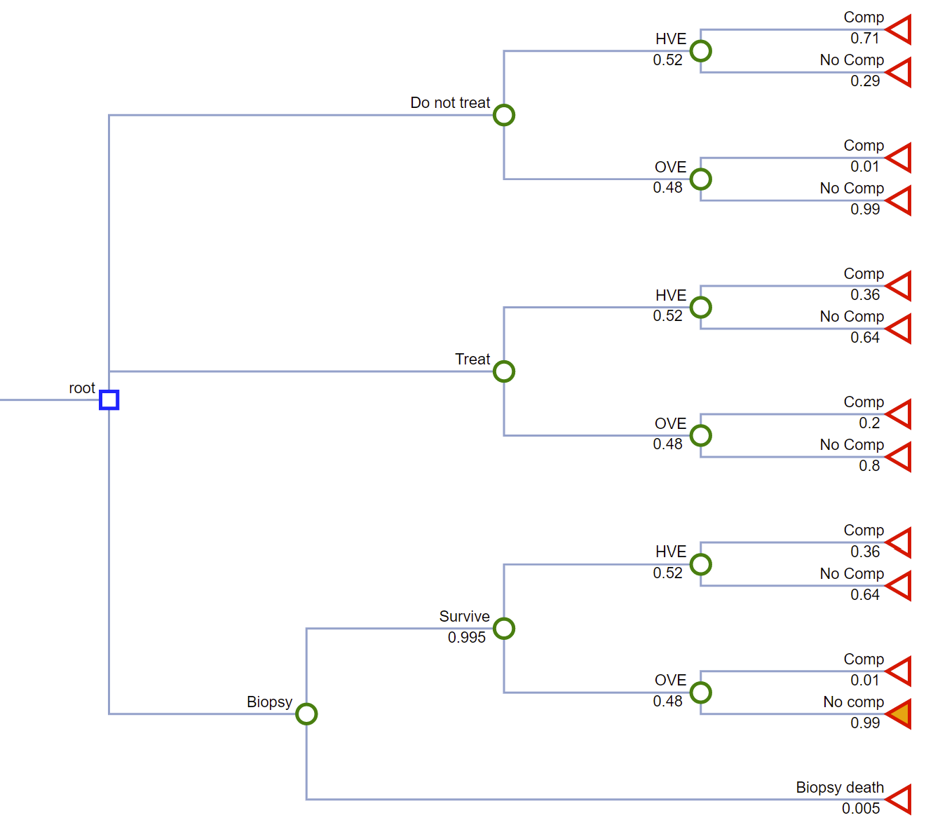
0.1920
0.1910

Slide 14
Estimating decision tree outcomes in R
Notes:
Eline

Slide 15
Compute average outcomes
The (average) expected value of the outcomes (i.e. cost, QALYs) of a strategy in a decision tree can be calculated by using the below steps:
Identify all branches in this strategy
Multiply all conditional probabilities in a branch
The product of all conditional probabilities is then multiplied with the outcome value of that branch
Repeat steps 2 and 3 for each branch
Sum (the product of conditional probabilities x outcome) for all branches under this strategy

Slide 16
Plot of a sample decision tree

Slide 17
0.995*0.52 = 0.5174
HVE
0.36
Survive
0.52
Biopsy
0.995
0.48
OVE
0.01
0.005
Biopsy death
1.00
0.995*0.48 = 0.4776

Slide 18
0.5174*0.36 + 0.4776 *0.01 = 0.1910
0.5174
HVE
0.36
Survive
0.52
Biopsy
0.995
0.48
OVE
0.01
0.005
Biopsy death
1.00
0.4776
0.1910 + 0.0050 =0.1960
0.005

Slide 19
Compute average outcomes – in R
The steps to calculate expected outcome(s) could be done easily in R in the following way:
Store the product of all conditional probabilities of each branch in a vector
Store the associating outcomes in a vector
Take the product of the two vectors using matrix multiplication.

Slide 20
R Session
Notes:
Part 1 = Showing code 3 state model
Part 2 = Exercise build Sick-Sicker model
Part 3 = Show answers of Sick-Sicker

